Slide 1
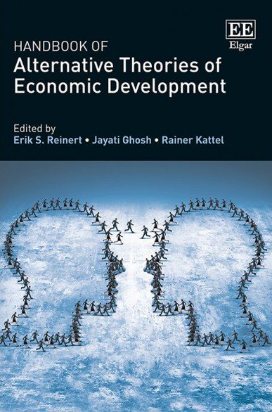

Slide 2
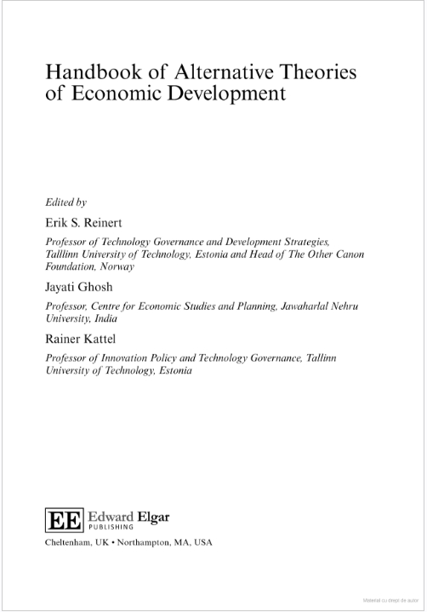
The subject matter is approached from several complementary perspectives.
From a historical angle, the Handbook charts the mercantilist and cameralist theories that emerged from the Renaissance and developed further during the Enlightenment.
From a geographical angle, it includes chapters on African, Chinese, Indian, and Muslim approaches to economic development.
Different schools are also explored and discussed including nineteenth century US development theory, Marxist, Schumpeterian, Latin American structuralism, and regulation theories of development.
Institutions. The Handbook has chapters on important events and institutions including The League of Nations, The Havana Charter, and UNCTAD, as well as on particularly influential development economists.
Contemporary topics such as the role of finance, feminism, the agrarian issue, and ecology and the environment are also covered in depth.

Slide 3
Contents:
1. Introduction
Erik S. Reinert, Rainer Kattel and Jayati Ghosh
PART I DEVELOPMENT THINKING ACROSS HISTORY AND GEOGRAPHY
2. Giovanni Botero (1588) and Antonio Serra (1613): Italy and The Birth of Development
Economics
Erik S. Reinert
3. Economic Emulation and the Politics of International Trade in Early Modern Europe
Sophus A. Reinert
4. Cameralism and the German Tradition of Development Economics
Erik S. Reinert and Philipp R. Rössner
5. Friedrich List: From “Spiritual” and Competitive Power to Collaboration
Arno Mong Daastøl
6. Kathedersozialismus and the German Historical School
Wolfgang Drechsler
7. Chinese Development Thinking
Ting Xu

Slide 4
8. The Economic Cycle of Imperial China and Its Development
Xuan Zhao
9. The Islamic World and Capitalism
Ali Kadri
10. Unity and Diversity in the Ottoman School of National Economy: A Reappraisal of Ziya Gökalp and Ethem Nejat
Eyüp Özveren, Mehmet Salih Erkek and Hüseyin Safa Ünal
11. Development Thinking in India
Goddanti Omkarnath
12. Latin American Structuralism: The Co-Evolution of Technology, Structural Change and Economic Growth
Mario Cimoli and Gabriel Porcile
13. Revisiting the Debate on National Autonomous Development in Africa
Issa G. Shivji
14. Development as the Struggle for Liberation from Hegemonic Structure of Domination and Control
Yash Tandon
15. The League of Nations and Alternative Economic Perspectives
Carolyn N. Biltoft
16. The Havana Charter: When State and Market Shake Hands
Jean-Christophe Graz
17. The UNCTAD System of Political Economy
Ricardo Bielschowsky and Antonio Carlos Macedo e Silva

Slide 5
PART II APPROACHES TO UNDERSTANDING DEVELOPMENT
18. Marxist Theory and the “Underdeveloped Economies”
Prabhat Patnaik
19. Economic Development as an Evolutionary Process
Richard B. Nelson
20. Classical Development Economists of the Mid-20th Century
Rainer Kattel, Jan A. Kregel and Erik S. Reinert
21. Development and Régulation Theory
Robert Boyer
22. The “Dependency School” and its Aftermath: Why Latin America’s Critical Thinking Switched from One Type of “Absolute Certainties” to Another, Gabriel Palma
23. Feminist Approaches to Development
Maria Sangrario Floro
24. Reading Freeman when Ladders for Development are Gone
Rodrigo Arocena and Judith Sutz
25. Albert O. Hirschman
Michele Alacevich
26. Michal Kalecki
Jayati Ghosh

Slide 6
PART III ISSUES IN DEVELOPMENT
27. The Agrarian Question and Trajectories of Economic Transformation:
A Perspective from Agrarian South
Sam Moyo, Praveen Jha and Paris Yeros
28. The Effective Demand Approach to Economic Development
Jan A. Kregel
29. Development Planning
C.P. Chandrasekhar
30. The Nordic Route to Development
Lars Mjøset
31. Competitiveness and Development: A Schumpeterian Approach
Mehdi Shafaeddin
32. Innovation Systems and Development: History, Theory and Challenges
Bengt-Åke Lundvall
33. Latecomer Industrialisation
John A. Mathews

Slide 7
34. The Developmental State in the Late 20th Century
Elizabeth Thurbon and Linda Weiss
35. Development, Ecology and the Environment
Edward B. Barbier and Jacob P. Hochard
36. Competition, Competition Policy, Competitiveness, Globalisation and Development
Ajit Singh
37. Knowledge Governance: Intellectual Property Management for Development and the
Public Interest
Leonardo Burlamaqui
38. Legal Structures and Economic Development
Jürgen G. Backhaus
39. Deindustrialisation and Premature Deindustrialisation
Fiona Tregenna
40. The Post-Soviet Industrial Extinctions and the Rise of Jihadi Terrorism in the
North Caucasus
Georgi Derluguian
41. Epilogue: The Future of Economic Development between Utopias and Dystopias
Sylvi Endresen, Ioan Ianos, Erik S. Reinert and Andrea Saltelli
Index

Slide 8
A time of ideological shifts.
US: The ideological extremes - Trump and Sanders – both agree on a) free trade is no longer good for the US b) the US (private) health care model is inefficient (Trump later changed on b).
UK: Brexit.
The old EU periphery: sinking deeply into debt and getting poorer (Greece, Italy, Spain, Portugal).

Slide 9
An 1848 moment….
…when the old order collapses because it is attecked from the political right and the political left at the same time.
Overly abstract theories collapse. The old elites are under attack from «all sides».

Slide 10
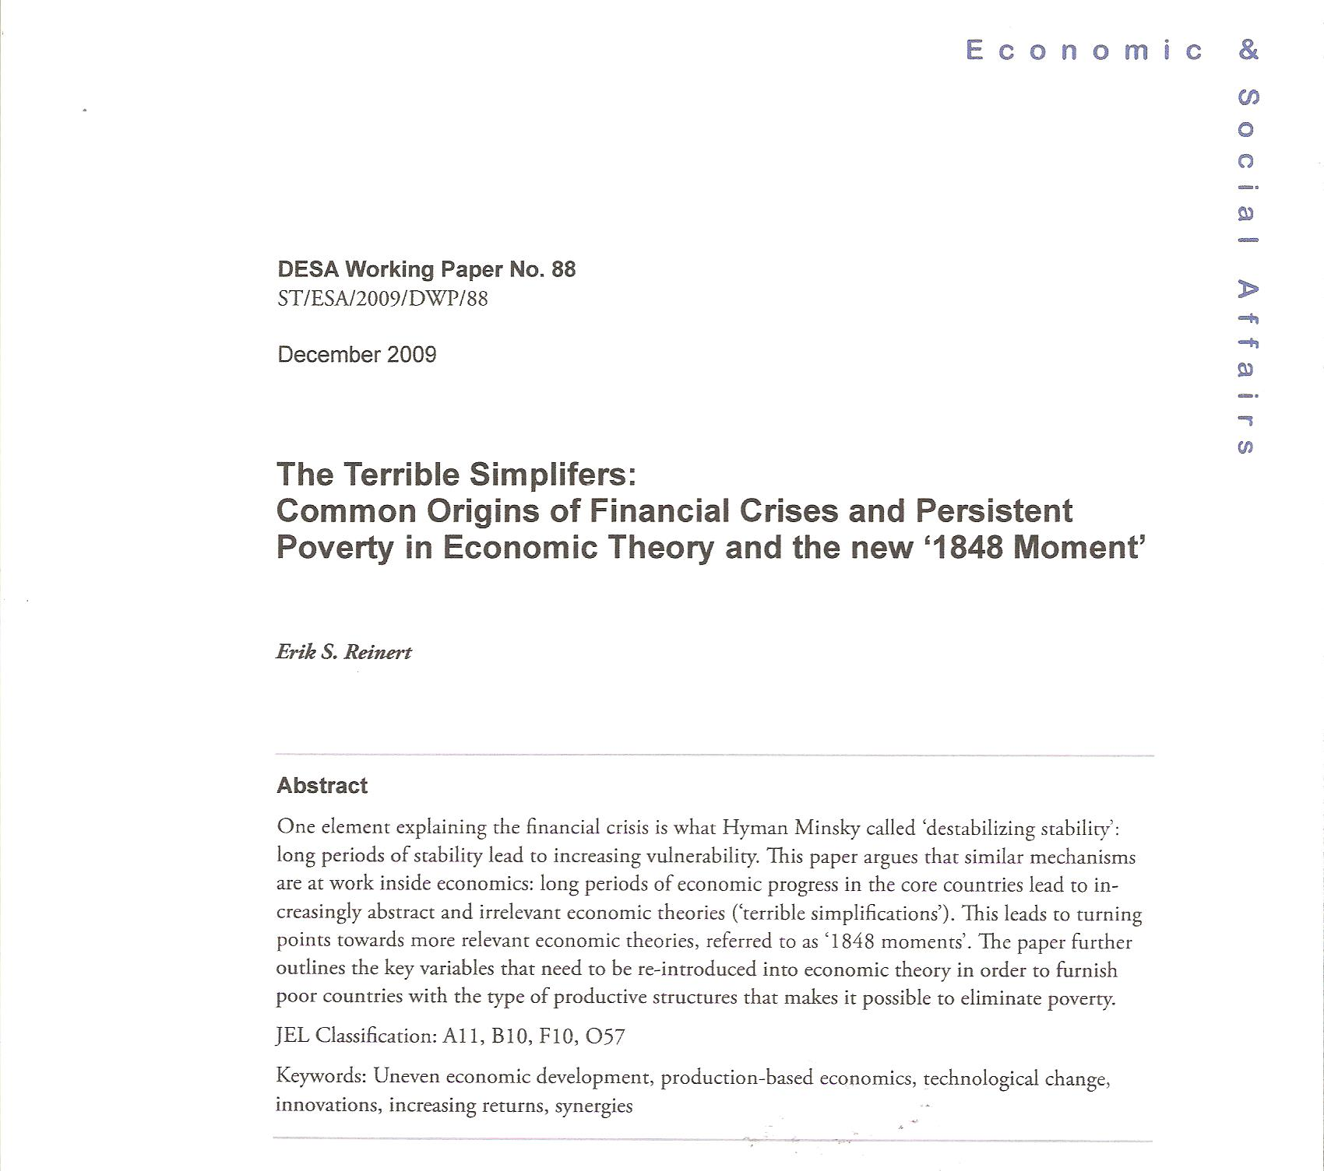

Slide 11
The ’1848 moment’:
‘It often happens that the universal beliefs of one age of mankind – a belief from which no one was, nor without an extraordinary effort of genius and courage could at the time be free – becomes to a subsequent age so palpable an absurdity, that the only difficulty then is to imagine how such a thing can ever have appeared credible...It looks like one of the crude fancies of childhood, instantly corrected by a word from any grown person.’
John Stuart Mill, 1848.

Slide 12
The 1848 Generation: three books – all from 1848 – covering the political spectrum from left to right, all recanting David Ricardo (i.e. creating less abstract theories).
Marx & Engels, Communist Manifesto.
Marx was so radical he had to flee to England.
Bruno Hildebrand, Economics of the Present and the Future.
H. was so conservative he fled to Switzerland.
John Stuart Mill, Principles of Political Economy.
English liberalism recanted on free trade!

Slide 13
The crisis that started in the 3rd World is now reaching the West.
Third World 1970s: De-industrialization, falling wages and disappearing middle class in small Latin American countries.
Second World 1990s: Massive destruction of industry in former Soviet Block. Wage collapse.
First World 2010s: De-industrialization, falling wages, disappearing middle class, Brexit, Trump/Sanders.

Slide 15


Slide 16


Slide 17
Harold Innis’ (1894-1952) dynamic taxonomy of knowledge.
Science, communicated in ’Latin’, gets more and more abstract, and enters into alliances with the political elites (T. Veblen’s vested interests).
Resistance to the ruling paradigm and the elites builds up among the ’vernacular’ (those who do not write Latin) and an overthrow may take place after a shock to the system.
Western Civilization is again and again saved by knowledge that for a time only survives in the periphery.

Slide 18
The Cyclical Movements of Economic Theory.
School Starting point Peak Death
Physiocracy Quesnay 1758 1760s ca. 1789
(’Rule of Nature’)
Classical Ricardo 1817 1840s ca. 1895
Economics
Neoclassical Samuelson 1948 1990s NOW
synthesis

Slide 19


Understanding the ‘isomorhism’ between communism and Western capitalism.

Slide 20
